Slide 1
Machine Learning
Unit - 1

Slide 2
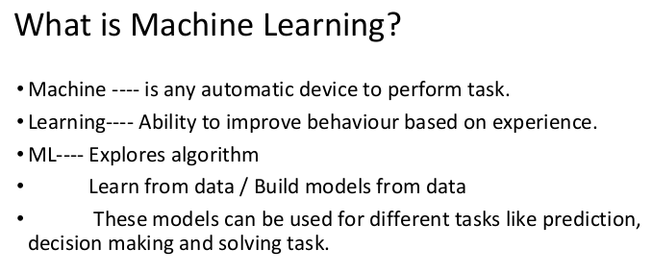
Introduction to Machine Learning

Slide 3
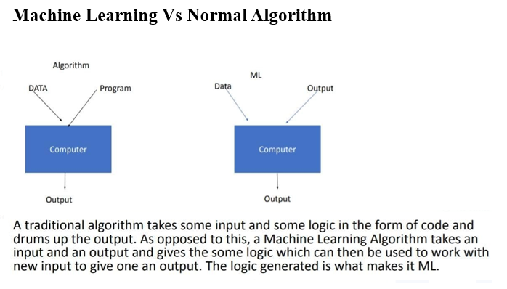

Slide 4
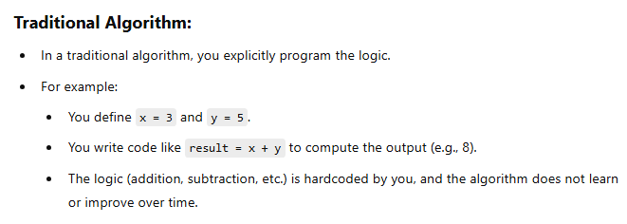
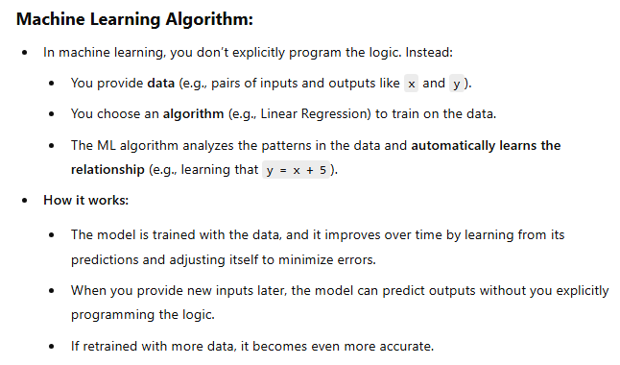
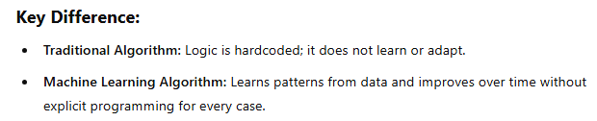

Slide 5
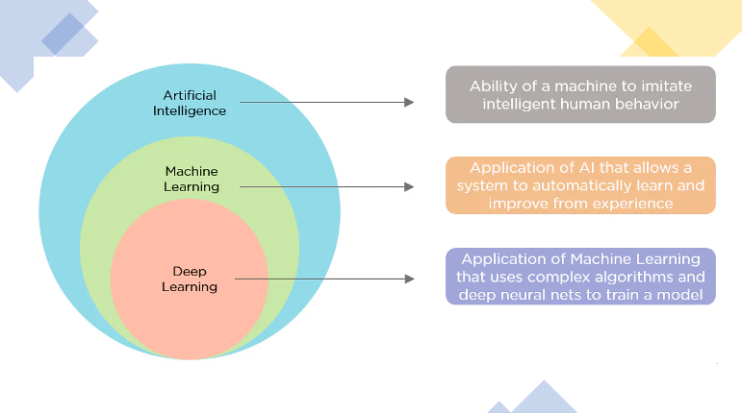
AI vs ML vs DL

Slide 6
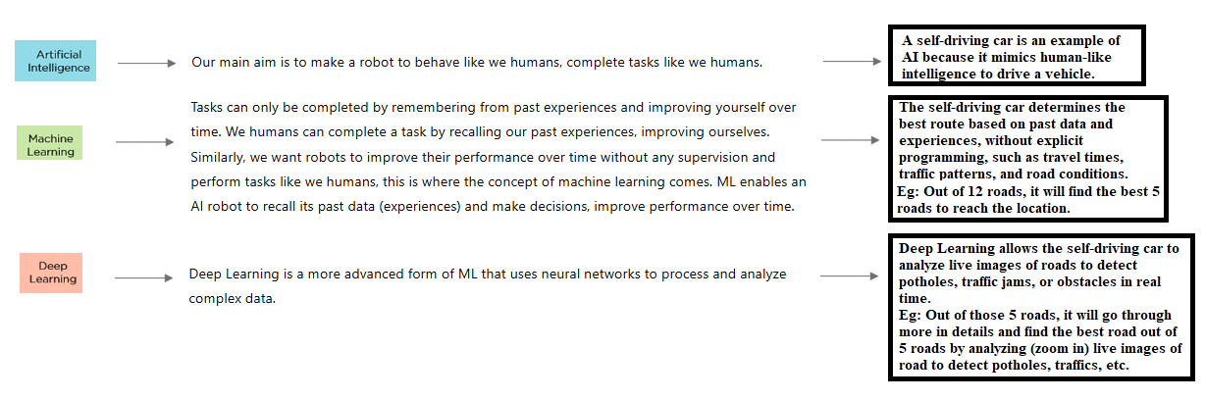
AI vs ML vs DL (Example of a selfdriving car)

Slide 7
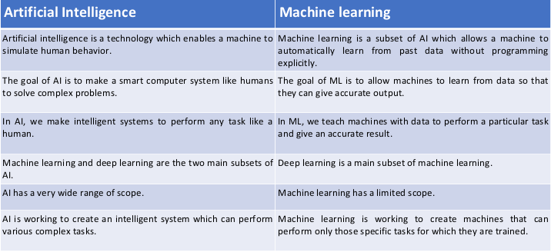
Difference between AI and ML:-

Slide 8
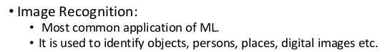
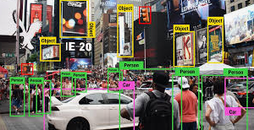
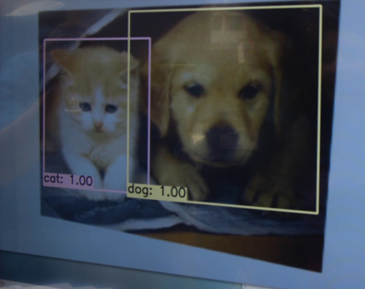
Applications of Machine Learning:-

Slide 9
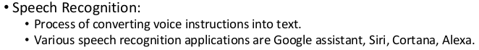

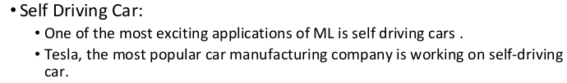


Slide 10
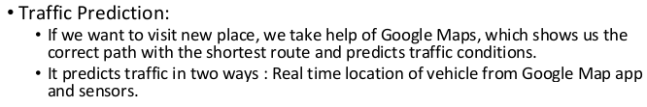
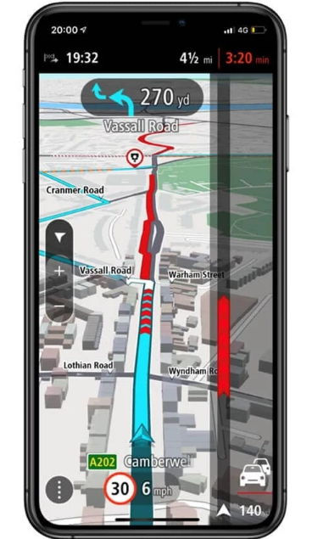

Slide 11
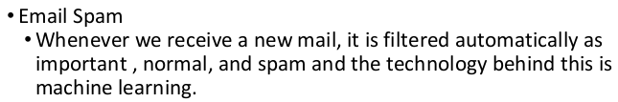
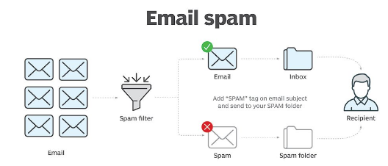
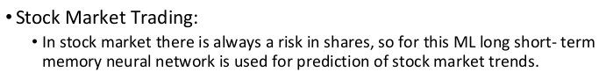



Slide 12
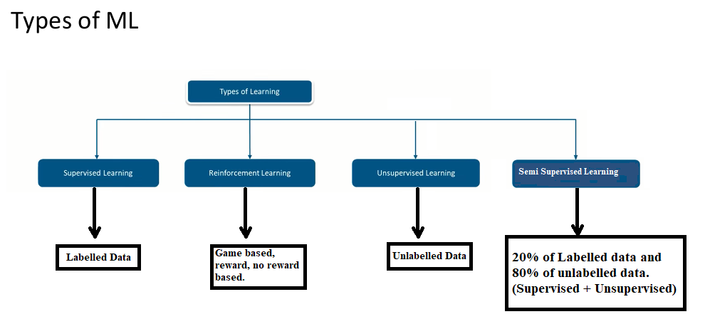

Slide 13
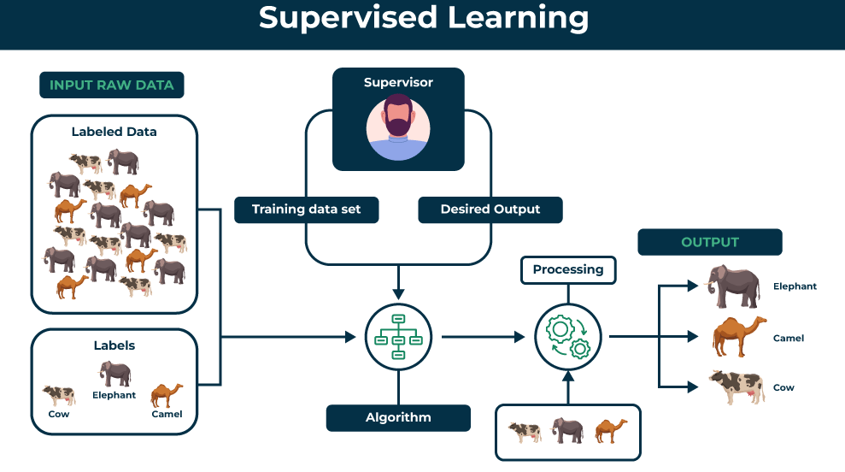
Supervised Learning:-

Slide 14
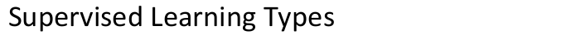
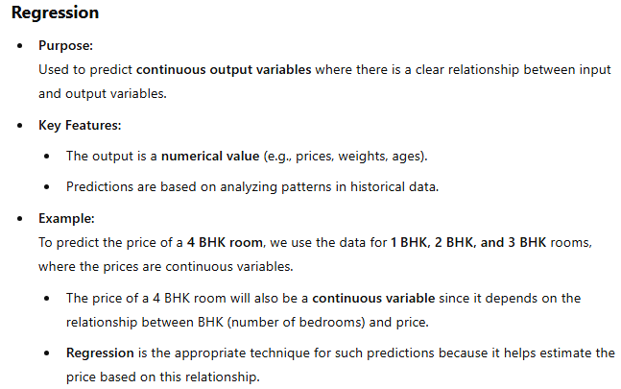
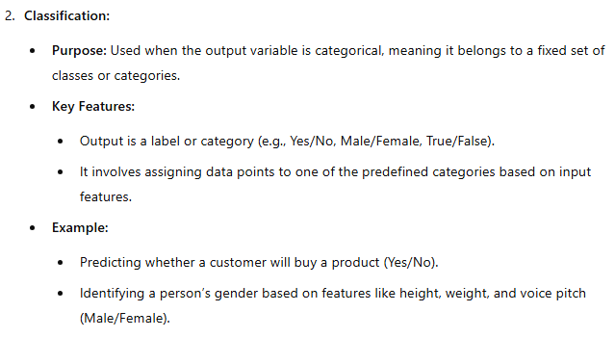

Slide 15
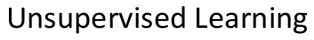
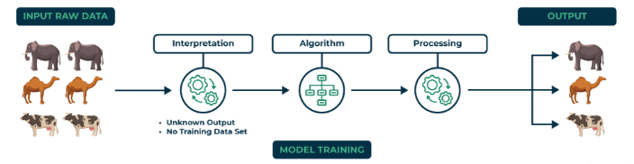

Slide 16
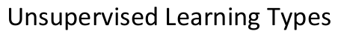
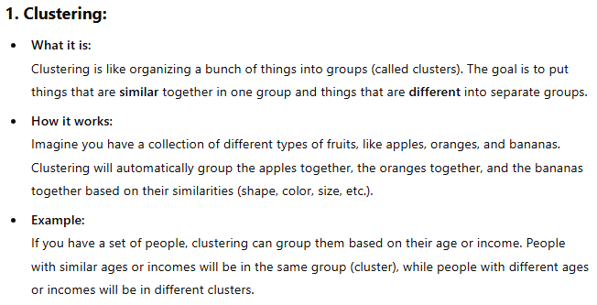
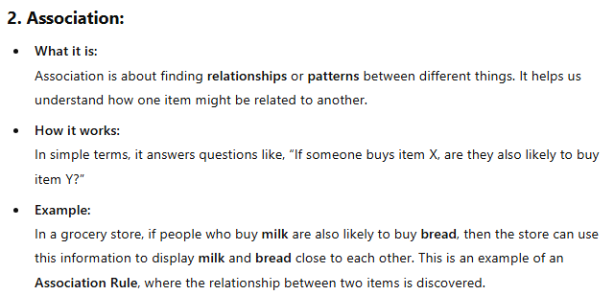

Slide 17
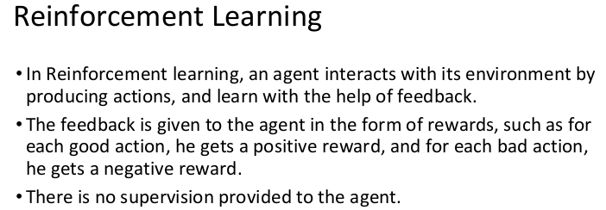
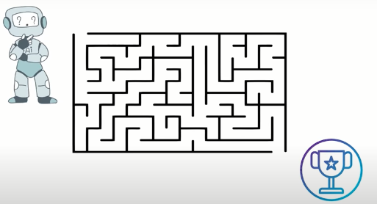

Slide 18
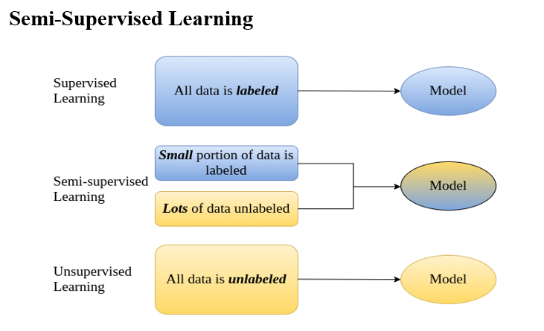

Slide 19
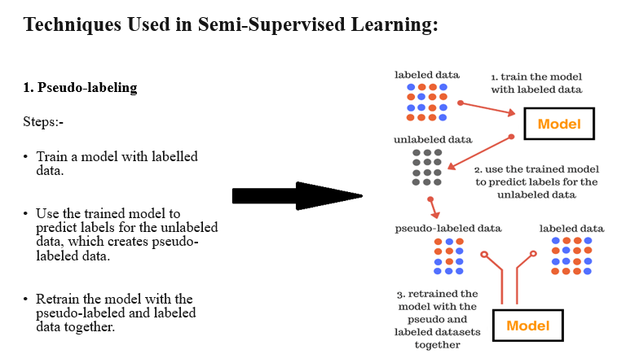

Slide 20
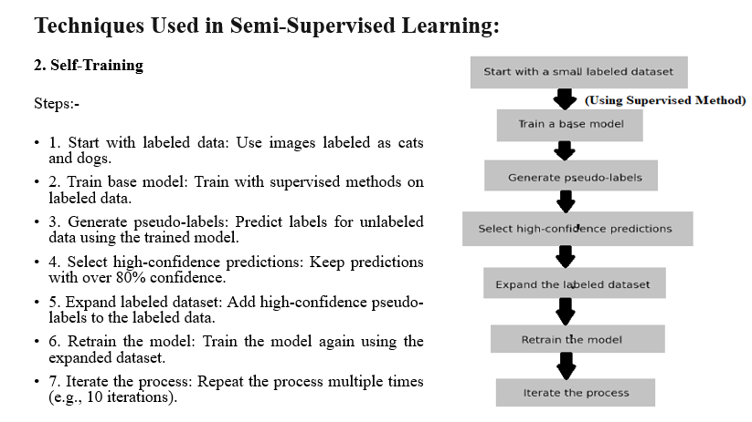

Slide 21
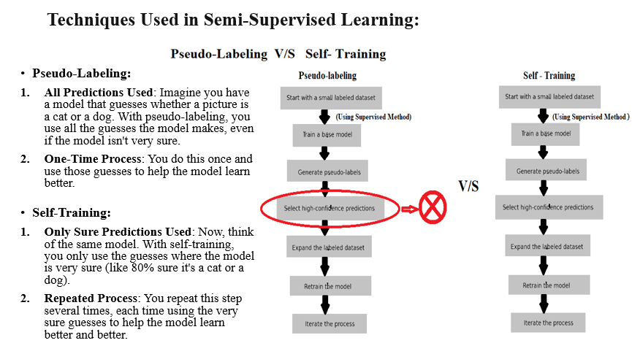

Slide 22
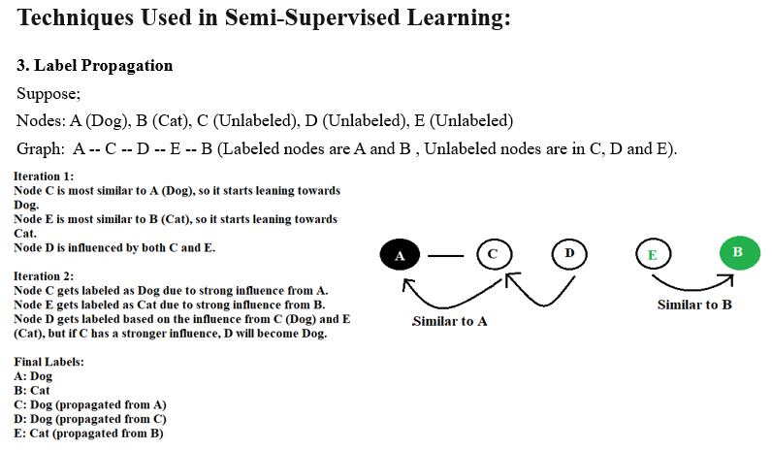

Slide 23
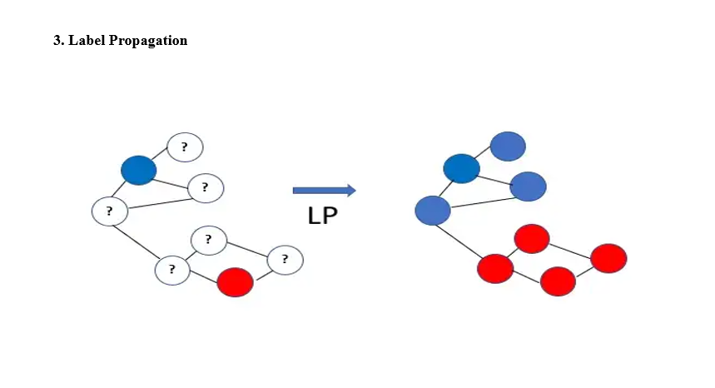

Slide 24
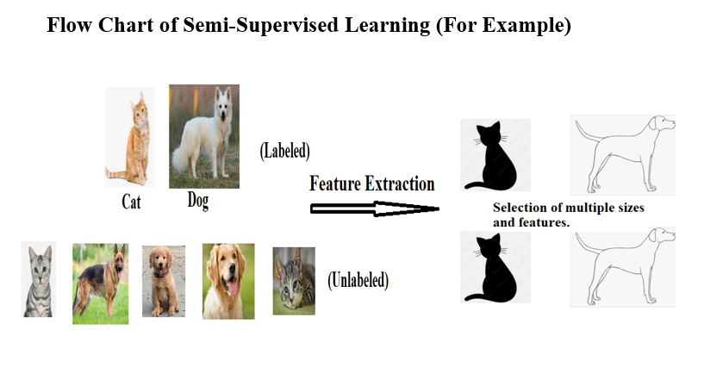

Slide 25
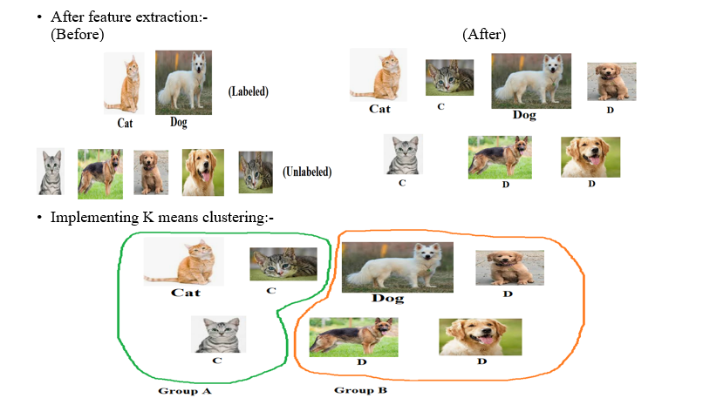

Slide 26
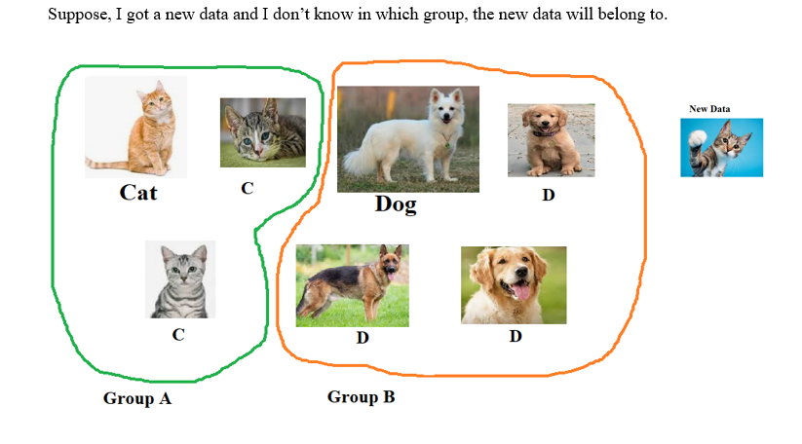

Slide 27
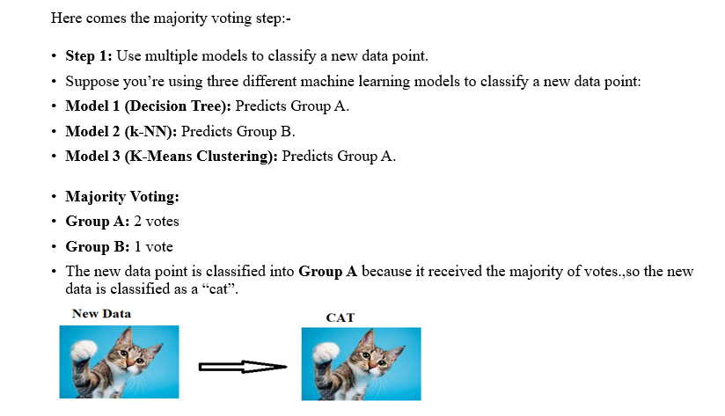

Slide 28
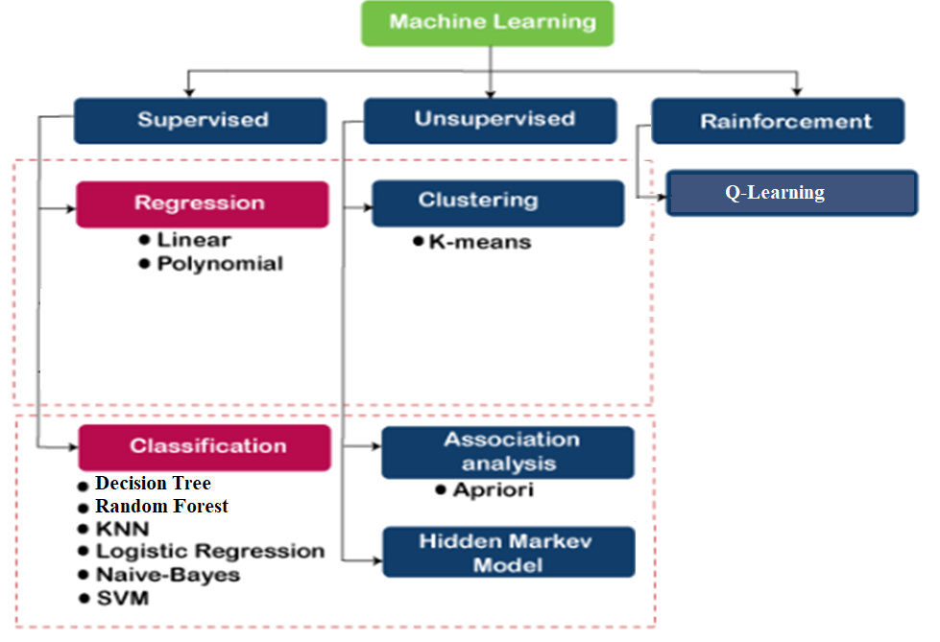
Types of Algorithm:

Slide 29
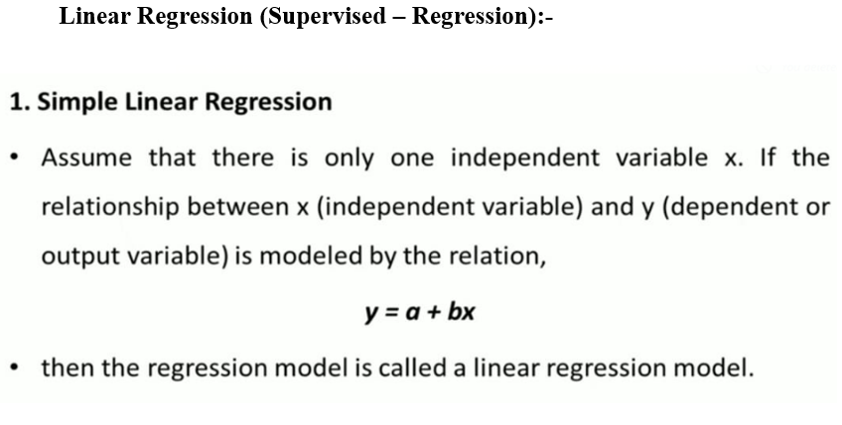
Supervised Algorithms (Regression):-

Slide 30
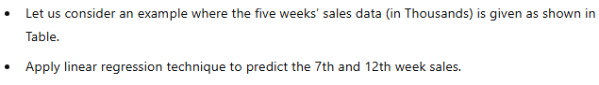
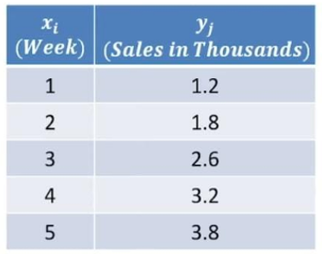

Slide 31
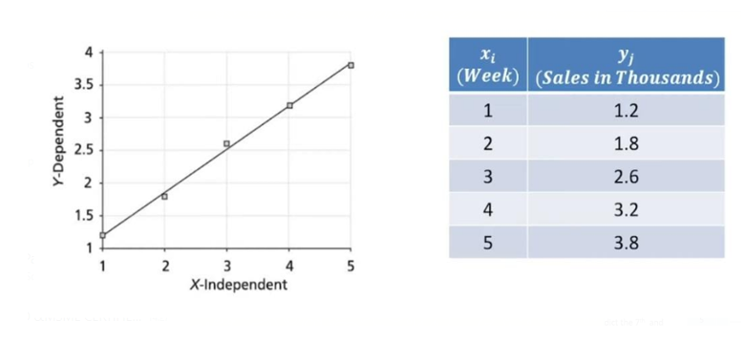

Slide 32
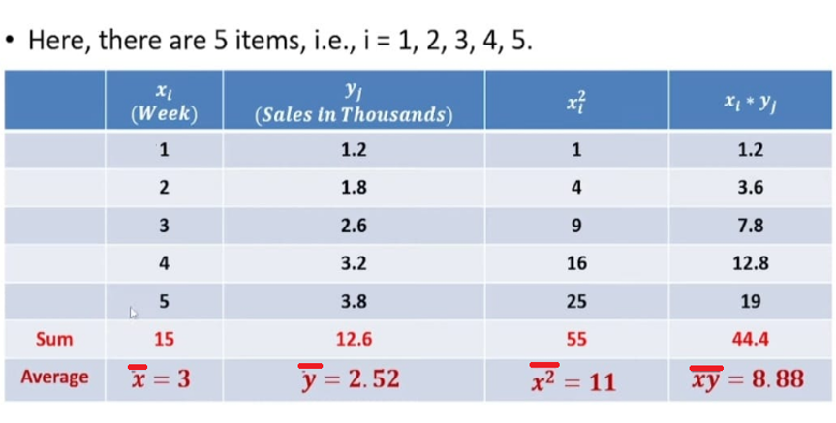

Slide 33
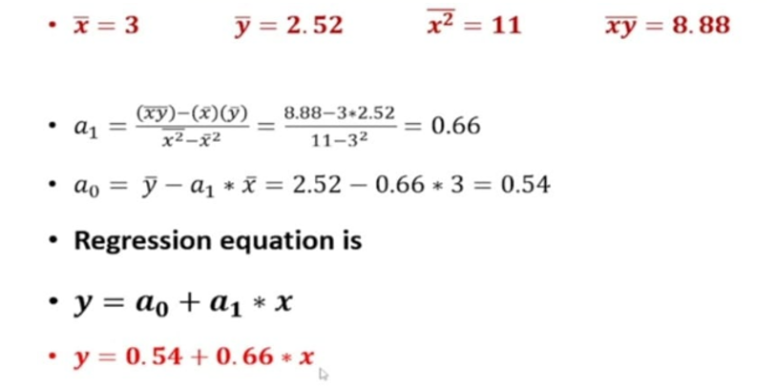

Slide 34
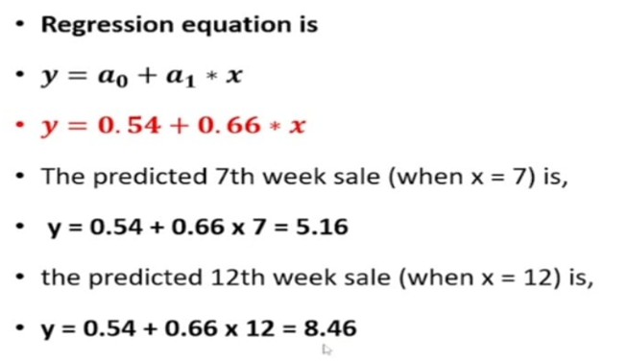

Slide 35
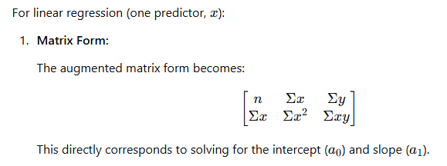
Another method to solve Linear Regression:-

Slide 36
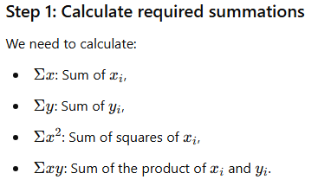


Slide 37





Slide 38



To solve we can use scientific calculator to get the
coeffients of a0 and a1.
The Answer will be :-

Slide 39


Slide 40



Slide 41


Slide 42



Slide 43


Slide 44


Slide 45


Another method to solve Multiple Linear Regression:-

Slide 46


Now, coming to the question:-

Slide 47


Slide 48


Slide 49



To solve we can use scientific calculator to get the
coeffients of a0 , a1 and a2.
The Answer will be :-

Slide 50


Slide 51


Slide 52



Slide 53


Slide 54


Slide 55

1. Decision Tree-
Supervised Algorithm (Classification):-

Slide 56


Slide 57


2. Random Forest-

Slide 58


Slide 59

3. KNN

Slide 60


Slide 61


KNN (Numerical Example):-

Slide 62


Slide 63




Slide 64

4. Logistic Regression-

Slide 65


Slide 66


Slide 67


Slide 68


Slide 69


Slide 70


Slide 71


Slide 72



Slide 73


Slide 74


Slide 75


Slide 76


Slide 77


Slide 78


Slide 79


Slide 80


Slide 81


Slide 82

5.

Slide 83


Slide 84


Slide 85
Connection of Bayes' Theorem with Naive Bayes' Classifier
Bayes' Theorem :
You already have probabilities:
For example, you know the chance of rain (prior probability).
You also know that if it rains, the probability of it being cloudy is 25%, and that if it is cloudy, there's an 80% chance it will rain.
Applying Bayes' Theorem:
You combine these probabilities using Bayes' theorem to find the posterior probability (the updated probability after considering all the factors).
This allows you to make a more informed decision about whether or not to go on the picnic, based on the updated probability.
Naive Bayes:
In Naive Bayes, the process is a little different:
You don’t have the probabilities initially, but you do have data or clues about the event.
For example, you may not know the probability of it raining when it is cloudy, but you calculate these probabilities from the data you have (e.g., how often it rained when it was cloudy in past data).
Finding Prior Probabilities:
You manually calculate the prior probability of each event (like the probability of rain or no rain) based on the data you have (e.g., how many times it rained out of 100 days).
Using Bayes' Theorem:
Once you have the prior probabilities, you apply Bayes' theorem to calculate the posterior probabilities.
Making a Decision:
After calculating the posterior probabilities for each possible event, you choose the event with the highest probability. For example, you might decide whether to go on the picnic based on which event (rain or no rain) has the higher posterior probability.

Slide 86


Slide 87


Slide 88


Slide 89


Slide 90

6. SVM or (SVC) Support Vector Classification

Slide 91



Slide 92

Here, we will focus on Support Vector Classification (SVM/SVC).

Slide 93


Slide 94

Now suppose, the data points are not linearly separable (i.e., they cannot be divided into two groups by a straight hyperplane in the given feature space), in that case, we will use a kernel in Support Vector Machines (SVM).

Slide 95


Slide 96


Slide 97

1. K-Means Clustering

Slide 98


Slide 99


Slide 100

2. Association

Slide 101


Slide 102


Slide 103


Slide 104


Slide 105


Slide 106


Slide 107


Slide 108


Slide 109


Slide 110


Slide 111


Slide 112

When to use supervised and unsupervised (real life scenario):-
Suppose, we have a dataset as shown below:-

Slide 113

Summary of dataset:-

Slide 114


Slide 115
Here are the aims :
Predict the house price based on the given features.
Generate an equation that can be used to predict the house price.
Decide whether a person should buy the house based on the given 13 features.

Slide 116
For aims:- Predict the house price based on the given features. Generate an equation that can be used to predict the house price.
First, we will determine whether we should use supervised or unsupervised learning. As you can see in the dataset, variables like price, area, and furnishing status can be used as target variables, and there is information about the target variable. This indicates that we are dealing with labeled data. Therefore, we will use supervised learning.
Now, within supervised learning, how do we decide whether to use regression or classification?

Slide 117



Slide 118


Let’s use Linear Regression:-

Slide 119



Slide 120



Slide 121




Slide 122



Slide 123



Slide 124



Slide 125



Output:-

Slide 126

Let’s use Polynomial Regression:-
In polynomial regression, the code will be similar like linear regression. Only difference is, instead of mentioning “multiple linear regression, we will write “polynomial” as shown below:-

Slide 127


Output:-

Slide 128



Slide 129

The function predicts the house price based on the given features by applying the regression equation with the provided coefficients and intercept.

Slide 130

Link of the code:-https://colab.research.google.com/drive/1AsA_xmE2qMwqu99hw0VImrVYzY2vkmHr?usp=sharing

Slide 131
For aim:- Decide whether a person should buy the house based on the given 13 features.
The aim of deciding whether a person should buy the house based on the 13 features is coming under classification tasks, not regression. So, we will implement, classification here.
Now coming to the question:- “Decide whether a person should buy the house based on the given 13 features.”:-
K-Nearest Neighbors (KNN): Since your task involves classifying based on specific features (such as area, bedrooms, bathrooms, etc.), and not based on the "distance" between instances, KNN is not ideal in this case.
Support Vector Machine (SVM): SVM works by finding a hyperplane that separates different classes (class 1 and class 0 in your case). While it can work for binary classification tasks, it is typically more suitable for cases where there is clear separation between classes with a defined boundary. For feature-based classification in your scenario (with continuous features like area, bedrooms, etc.), SVM might not be the best choice.

Slide 132
Naive Bayes: Naive Bayes is a probabilistic classifier, but it assumes the features are conditionally independent given the class. Since you're working with multiple features, some of which might be correlated, Naive Bayes may not give the best results for this kind of classification task.
Decision Tree: A Decision Tree splits the data based on features to make decisions, but it can easily overfit (become too complex) when working with many features.
Random Forest: A Random Forest is like a collection of Decision Trees. So, if decision tree is not a good idea then of course Random forest is also a bad idea.
Logistic Regression: Logistic Regression is a binary classification algorithm that estimates the probability of a binary outcome. It's ideal for classifying whether someone will buy a house (class 1) or not (class 0), based on the features provided.
Since our task is binary classification (deciding whether to buy the house or not, and possibly also classifying the furnishing status), Logistic Regression is indeed a good choice. It directly models the probability of the target class and works well with continuous features like area, bedrooms, etc.

Slide 133



Slide 134





Slide 135




Slide 136



Slide 137


Link of the code:- https://colab.research.google.com/drive/1ErLm_eSxFkQjKIwXjS-w-TMnllR3LMvm?usp=sharing

Slide 138

Let’s see another dataset:-

Slide 139


Slide 140
The dataset contains features like child mortality, exports, health, etc., along with the name of the country.
However, there is no label indicating the category or status of each country (e.g., rich, poor, developed, underdeveloped, etc.).
Since there are no predefined labels or classifications for the countries, unsupervised learning is the appropriate approach to analyze this data.
Unsupervised learning, specifically clustering, helps group similar countries together based on their features.
The key point here is that we are discovering patterns and grouping the data based on its inherent characteristics, without relying on any labeled information.
This makes unsupervised learning the right choice for such scenarios!

Slide 141



Suppose, our aim is to classify countries into two groups.

Slide 142



Slide 143




Slide 144



Slide 145




Slide 146



Link:- https://colab.research.google.com/drive/18k2ruRtq02ZbFQuMrM2dlEyquI2CKHDQ?usp=sharing

Slide 147


Applications of Machine Learning Algorithms

Slide 148




Slide 149


